Slide 1
Contact + Source
Blog: www.raymondcamden.com
Email: raymondcamden@gmail.com
Twitter: raymondcamden
Source (slides + code): https://github.com/cfjedimaster/vue-pearson-workshop

Slide 2
Up to Speed with Vue.js
Section 1 – Beginning Vue.js

Slide 3

Why?
Notes:
what follows are my reasons for falling in love with vue.
these are very personal reasons and you may not agree with them and that’s cool
angular, react, vue, etc, they all have a way of doing stuff and im a strong believer in finding the one that works for you and being successful

Slide 4

Simple
Notes:
Simple – in some ways it feels like a better jquery. that isn’t a slight on jquery at all. but as an example, if i have a small bit of interactivity i need to add to a page, like a ajax based search using a few form fields. To me, angular feels like overkill, especially when I’m not building a SPA. So I’d use jQuery or do it vanilla. Vue feels like it fits in perfect here.

Slide 5
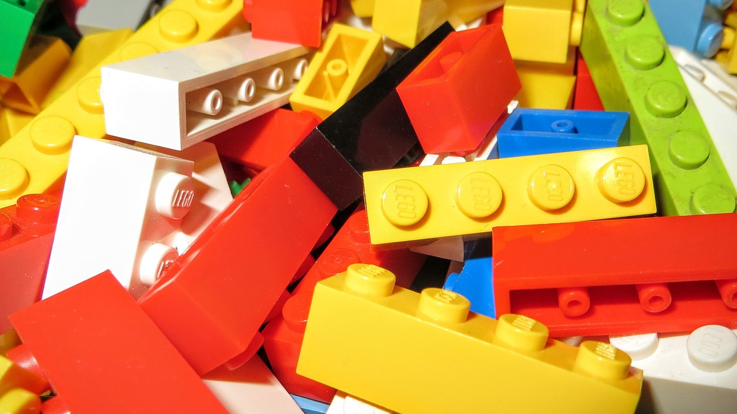
No Build Process
Notes:
not anti build. build processes are SUPER useful
but when i want to learn, when i want to play, etc, i always felt like angular wasn’t something i can play with – and that’s MY fault to be sure
but with Vue i found myself doing a HECK of a lot more because i could slap a script tag in and just go totown

Slide 6

Scalable
Notes:
with all that said, Vue absolutely DOES scale up to the more complex use cases. you want a build process. you’ve got a webback enabled CLI to go to town. you want a SPA. you got it. you wanr a mobile app? you can use it with Apache Cordova, you can use it with Ionic soon, you can use it with NativeScript now.

Slide 7
What?
Notes:
now lets talk about some of the specifics

Slide 8

Quick Vue Facts
Created by Evan You (@youyuxi)
Released in February of 2014
Currently is version 2.5.16
Main site: vuejs.org
GitHub: https://github.com/vuejs

Slide 9
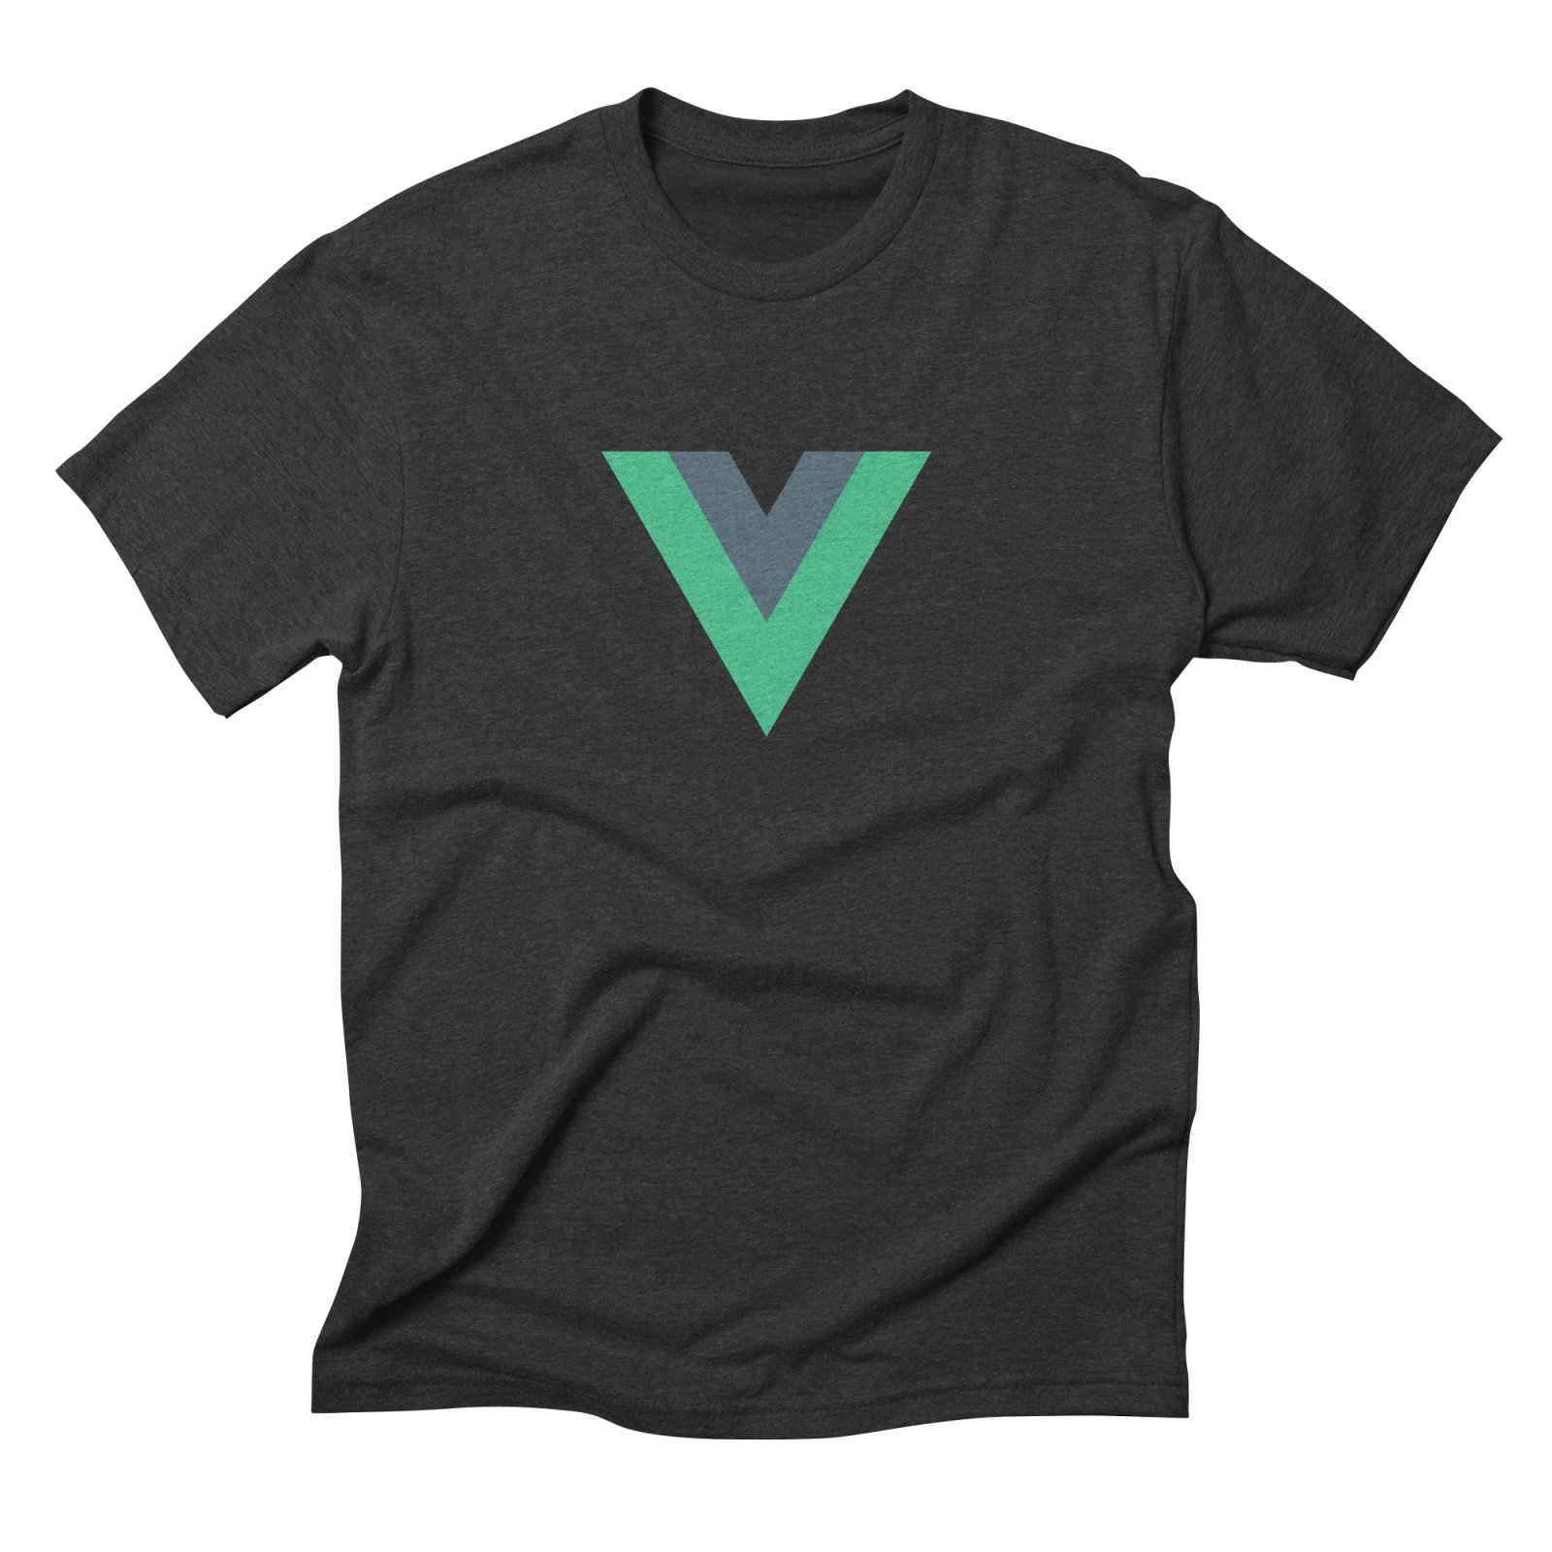
Even More Vue Facts!
Docs: https://vuejs.org/v2/guide/
Forum / Chat
Tooling
Newsletter, blog, twitter (@vuejs), jobs board
T-Shirts!
Notes:
Docs also includes style guide - API docs and examples and a cookbook – also translations (Chinese, Japaanese, Russion, Korean, Portg, French, a Vietemese
Tooling – VSC plugin + Devtools + CLI

Slide 10
What again?
Two-way binding between your DOM and JavaScript
Template Language (aka Declarative Rendering)
And I know I said this - but it does more. A lot more.
Notes:
So I’ve been talking about the ‘what’ for vue and focused more on the high level project stuff, not the library itself. Let’s talk about that at a SUPER high level.
first is binding – nothing terribly special about that. this is a fancy way of saying – i’ve got a form field, I change the value. i have some JS using that value and it automatically knows about the change and can do – whatever. Vice versa, if I use Ajax to load something anf stuff i tin a value, and I said the form field is bound to that value, I know that as soon as I set it after the Ajax thing is done, the UI updates automatically. This is not new of course.
Template language – think stuff like Handlebars, Jade, and so forth. Why do you care? If yuo’ve ever gotten some stuff from Ajax and built a string of HTML to inject into the DOM, you kow that a template language makes this much easier. Vue has a very nice template language –it reminds me a lot of Handlebars (although nice rimo)
And to be clear – it does more – but when I first started learning Vue, it was helpful for me to kind of restrict it to a few basic things

Slide 11
How?
Notes:
what follows are my reasons for falling in love with vue.
these are very personal reasons and you may not agree with them and that’s cool
angular, react, vue, etc, they all have a way of doing stuff and im a strong believer in finding the one that works for you and being successful

Slide 12

Installation
npm install
cli install
Download the bits from the site
Copy and paste a script tag!

Slide 13
<script> Style
Development Version
<script src="https://cdn.jsdelivr.net/npm/vue/dist/vue.js"></script>
Production Version
<script src="https://cdn.jsdelivr.net/npm/vue"></script>

Slide 14
Write Some Code!
Identify where you're going to render stuff
Setup some data
Render that data
Add events (ie on this do that) and other fancy stuff

Slide 15




Willy Nilly DOM Manipulation
$('#somediv').html('woot');
$('#someotherdiv’)
.attr(“src”, “something.jpg”);

Slide 16
Defining Vue’s “Place”

Slide 17
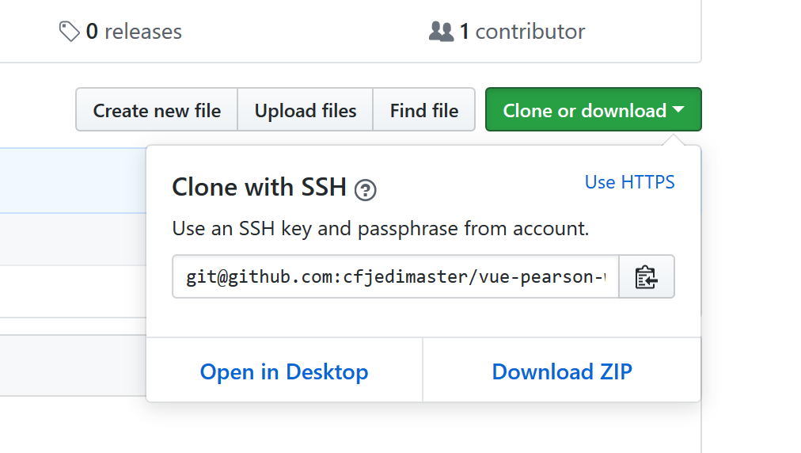
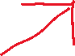
Vue Basics
https://github.com/cfjedimaster/vue-pearson-workshop
Notes:
No preferred editor.
I’m using Visual Studio Code – free, open source, works on every platform. Is really really cool.
Every slide will also have a footer saying what file I’m working on so it’s hopefully easy to follow along.

Slide 18
Examples – Let’s start easy!
Just one step above hello world...
File: code/1.0.html, code/1.1.html

Slide 19
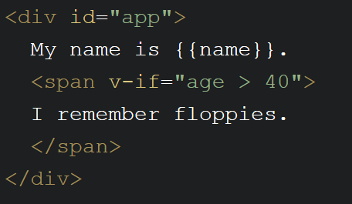
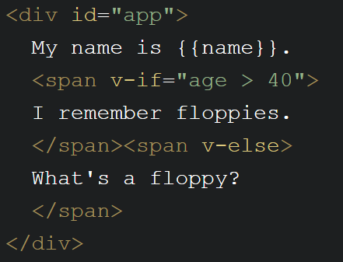
Examples - Conditionals
File: code/1.2.html, code/1.2a.html, code/1.3.html, code/1.4.html

Slide 20
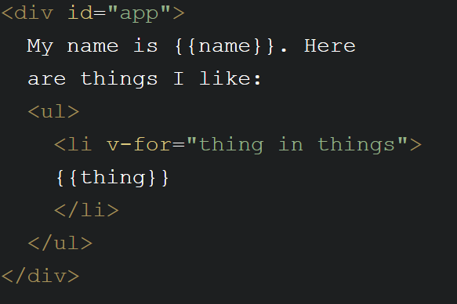
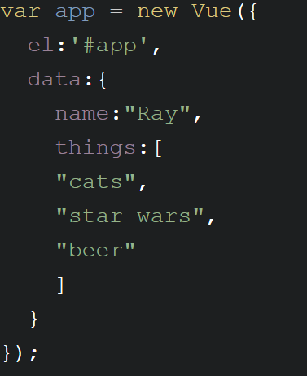
Examples - Loops
File: code/1.5.html, code/1.5a.html, code/1.5b.html, code/1.5c.html

Slide 21
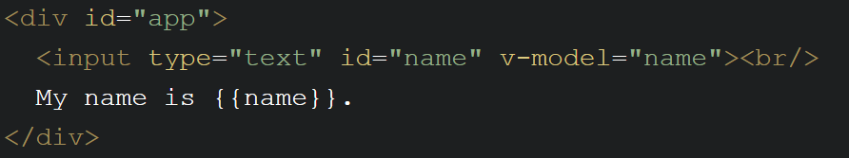
Examples – Form Field Binding
v-model connects a form field to data in Vue
Works with all kinds of form fields
File: code/1.6.html

Slide 22
Examples - Events
v-on:EVENT="FUNCTORUN"
v-on:click="something"
Defined in methods block of Vue instance
Easy to do modifiers (v-on:submit.prevent)
@click=“something”
File: code/1.7.html

Slide 23
Examples – Attribute Binding
v-bind:attribute=“value”
:attribute=“value”
v-bind:style="{bgcolor:curColor, font-style:textStyle}"
v-bind:class="{highlighted:isActive, color:appStatus}"
File: code/1.8.html

Slide 24
Examples – Computed Properties
Virtual properties
Property X is based on real data A and B
Defined in the computed part of the Vue instance
File: code/1.9.html, code/1.9a and code/1.10.html

Slide 25
Examples – Vue’s Lifecycle
Events that occur while a Vue instance is doing stuff
beforeCreate, created, beforeMount, mounted, beforeUpate, updated, activated, deactivated, beforeDestroy, destroyed, errorCaptured
https://vuejs.org/v2/api/#Options-Lifecycle-Hooks
File: code/1.11.html

Slide 26
Quick Recap
How to add Vue to a page and start an "app"
How to use the template language
How to listen for events and bind DOM attributes
How to work with "virtual" data
How to do stuff as Vue loads

Slide 27
Exercise One - Palindrome
A word (or phrase) that is the same forwards and backwards
Let the user type something in...
And report if it is a palindrome
Code’s in /code/exercise1.1

Slide 28
Exercise Two – Ajax Search
Take user input
Search against iTunes
Render results
https://itunes.apple.com/search?term=X&limit=10&media=music
Code’s in code/exercise1.2

Slide 29

Break

Slide 30
Up to Speed with Vue.js
Section 2 –
Building Components

Slide 31
What are components?
Re-usable objects of awesome-ness
Template + Logic + Style(*) = Component
Accepts properties and can emit events
Can be global or local to a Vue app

Slide 32
Examples – A Component
How to define a component
How to use a component
File: code/2.1.html

Slide 33
Properties
One way communication
Can just list – or define types, required, etc
Types: String, Number, Boolean, Function, Object, Array, Symbol
You don’t have to define everything
File: code/2.2.html, code/2.3.html, code/2.4.html

Slide 34
Events
How components ‘talk’ to their parents
Component: $emit(‘someNameHere’, data)
Parent: v-on:someNameHere
File: code/2.5.html

Slide 35
Slots
Allow you to compose values to be passed in
<p text="Hey buddy, thank you for doing that thing. I appreciate it. Here's a kitten."></p>
<p>
Hey buddy, thank you for doing that thing. I appreciate it. <strong>Here's a kitten.</strong>
</p>

Slide 36
Slots
<mything thankyou="Hey buddy, thank you for doing that thing. I appreciate it. Here's a kitten."></mything>
<mything>
<div slot="thankyou">
Hey, I want to <i>really</i> thank you for taking
the time to do whatever. We here at Mega Corp truly
care that you took the time. Oh, and here, please
take a kitten!
</div>
</mything>

Slide 37
Examples - Slot
Show how to define a slot
How to render it
File: code/2.6.html, code/2.6a.html

Slide 38
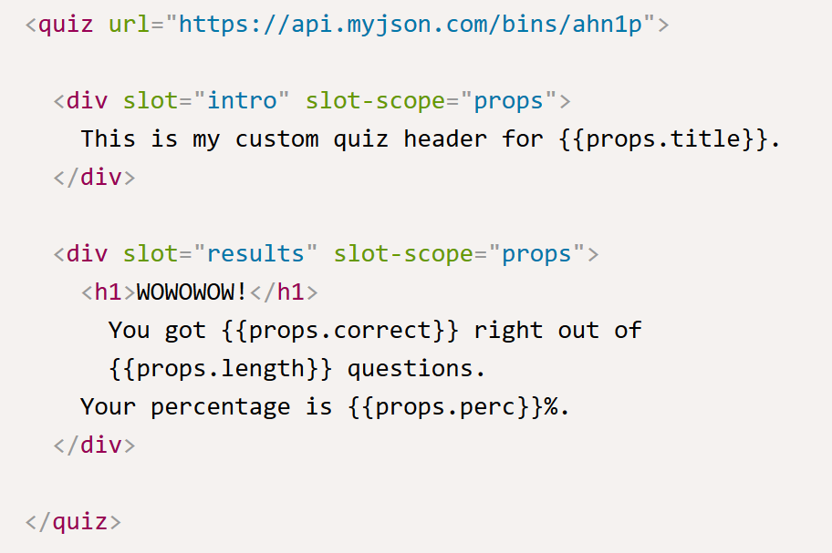
More Slots...
Multiple named slots
Slots can access component data

Slide 39
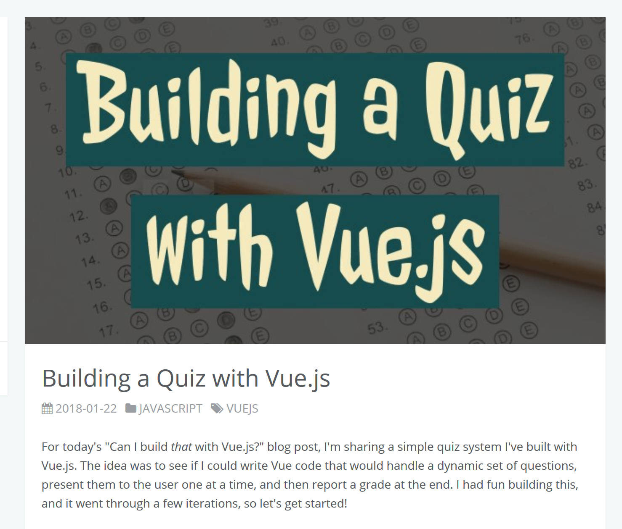
https://www.raymondcamden.com/2018/01/22/building-a-quiz-with-vuejs/

Slide 40
Exercise One – Music Component
Take exercise 1.2 and turn results into component
Code’s in code/exercise2.1

Slide 41
A Bit More on Components
There’s a Crap Ton
Google Static Maps: https://www.npmjs.com/package/vue-static-map
Bootstrap: https://bootstrap-vue.js.org/
Vuetify: https://vuetifyjs.com/en/

Slide 42
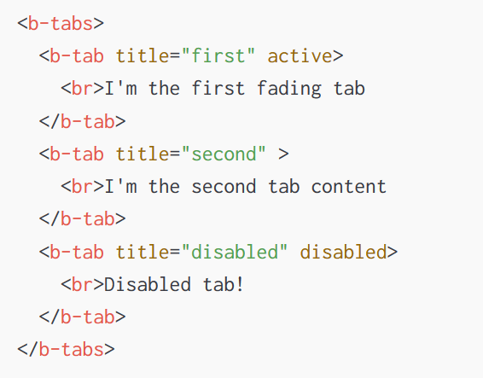
Bootstrap-Vue Example

Slide 43
Break

Slide 44
Up to Speed with Vue.js
Section 3 –
Working with Routing

Slide 45
Routing
Not a part of Vue
Official library: vue-router (https://router.vuejs.org)
“If I’m at location /foo, I want to do Foo”
“If I’m at location /goo, I want to go Goo”
We’re now in App Country

Slide 46
Getting Started
Define (and figure out) your routes
Create a VueRouter object
Pass it to Vue
Define a place to render routes
File: code/3.1.html, code/3.2.html

Slide 47
Even More Routing...
Nested Routes
Programmatic Navigation: router.push(....)
Named Routes
A heck of a lot more...

Slide 48
Exercise One –Master/Detail
App has a master view (list of films) and detail (specific film)
Use the Star Wars API (swapi.co)
Code’s in code/exercise3.1

Slide 49
Break

Slide 50
Up to Speed with Vue.js
Section 4 –
State Management with Vuex

Slide 51
State Management?
Solves a problem you may not have!
One Vue app – one set of data = easy
One Vue app, a few components = mostly easy
Many many components, lots of data = um...

Slide 52
Vuex
Another library (deeply integrated)
https://vuex.vuejs.org/
“Store”
Components can read from the store
Components can’t write to the store - directly

Slide 53
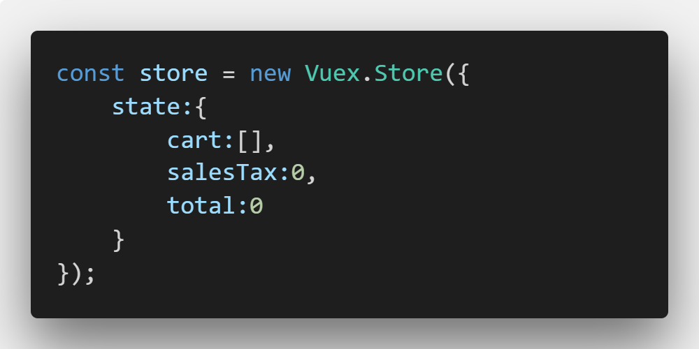
Vuex Basics

Slide 54
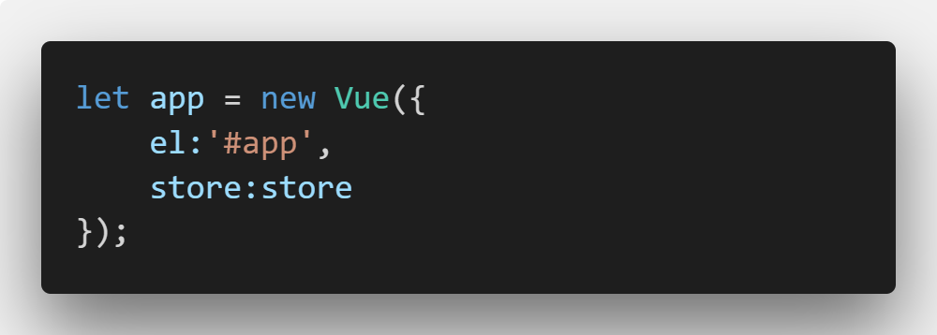
Vuex Basics

Slide 55
Vuex – Getting Data
Use store.state.X
Use a getter (defined in the store)
File: code/4.1.html

Slide 56
Vuex – Setting Data
mutations
actions

Slide 57
Mutations
Defined in the Vuex Store
Each has a particular name
State is passed automatically
Additional optional payload
File: code/4.2.html

Slide 58
Actions
Similar to before – just async. ;)
Actions will fire off commits to mutations...
Or you modify state directly
Passed context object and optional payload
File: code/4.3.html

Slide 59
More...
Modules
Plugins
Devtools Integration
https://vuex.vuejs.org
Notes:
Essentially sub stores
allow you to ‘hook’ into calls to your store (example, logging)

Slide 60
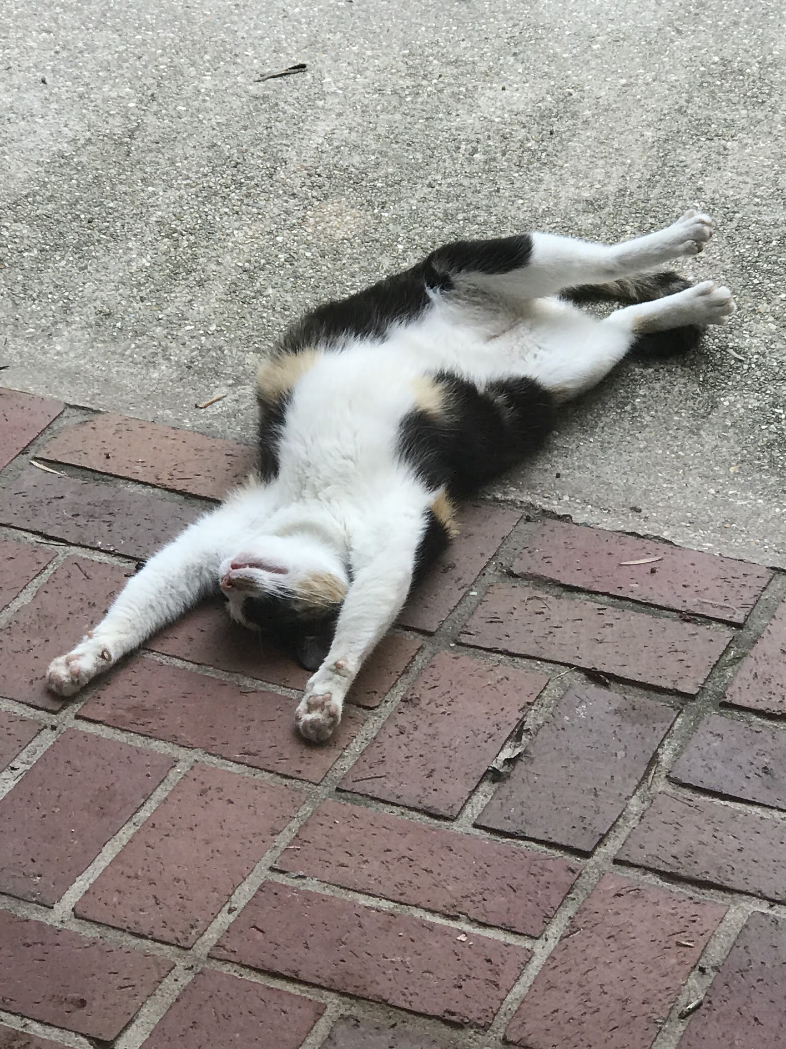
Exercise One – Cat Store
CRUD for Cats
UI to add, edit, update, and delete cats
Code’s in code/exercise4.1

Slide 61
Break

Slide 62
Up to Speed with Vue.js
Section 5 –
Using the CLI + Resources

Slide 63
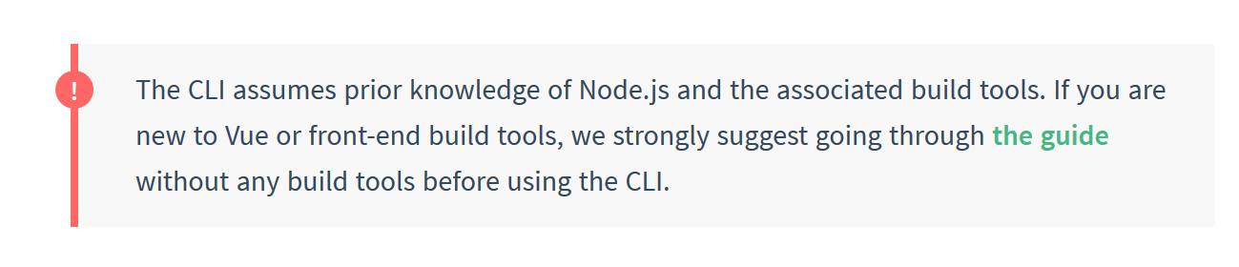
Yes, a CLI exists!
https://github.com/vuejs/vue-cli
Scaffolding
Currently in beta! (3.x)

Slide 64
Install
npm install –g vue-cli (OLD!!!!)
npm install –g @vue/cli (HIPSTER!!)

Slide 65
Quick Demo
Show running the CLI (for general help)
Show scaffolding an app
Show starting the server
Notes:
run vue –h
run vue create X
cd into test dir
npm run serve
open it up in the browser
and then show the files
TODO: how to add navigatin

Slide 66
Prototyping
Plugin: npm install -g @vue/cli-service-global
vue serve Component.vue

Slide 67
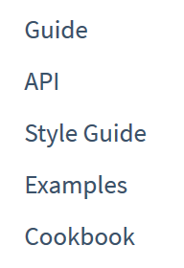
Resources (Learning)
https://github.com/vuejs/vue-devtools (Chrome, Firefox, and standalone via Electron)
Sarah Drasner on CSS-Tricks: https://css-tricks.com/intro-to-vue-1-rendering-directives-events/
Make note of her transition/animation posts
My Stuff: https://www.raymondcamden.com/tags/vuejs
Vuejs.org itself!

Slide 68
Resources (Cool Stuff)
VuePress - https://vuepress.vuejs.org/
Nuxt.js - nuxtjs.org
Newsletters:
https://www.getrevue.co/profile/vuejs-developers
https://news.vuejs.org

Slide 69

Notes:
END QA

